Slide 1
Fiserv EAP 6 & 7 Architecture Review
Toufic Arabi
Senior Consultant
August 15th 2016

Slide 2
JBoss EAP 6 & 7 Overview

Slide 3
JBoss EAP 6
New Features
Fully Modular Classloading system
Boot Process
Flexible Management
Managed Domains
Profiles
Directory Structures & Scripts
JNDI Lookups
JMS

Slide 4
JBoss EAP 6
New Features
Fully Modular Classloader | Boot Process | Flexible Management | Running Modes & Profiles
Java EE 6 standard compliant | lazy loading of unwanted services | Management functionalities in one improved console | Standalone & Domain
Offers application isolation. Only loads classes needed by the application | Concurrent start of needed services | Command Line Interface (CLI) | profile is a collection of subsystems
Concurrent loading of classes vs hierarchical |  |  | A standalone JBoss instance runs a single profile whereas a domain can run multiple

Slide 5
JBoss EAP 6
Profiles
A JBoss EAP 6 profile is a collection of subsystems
A standalone JBoss instance runs a single profile whereas a domain can run multiple
Four pre-configured profiles:
Default
High Availability (HA)
Full
Full-HA

Slide 6
JBoss EAP 6
Managed Domains
Combine virtual servers on physical hosts into server groups
Server groups share configurations and deployments
All configurations pass through the domain controller
Ability to run multiple server instances on the same physical hosts via socket bindings

Slide 7
JBoss EAP 6
Managed Domains
Host 2
SG-A
Server A
Host 1
SG-B
Server B
Domain Controller
Host 3
Server C
SG-C
Server D
Notes:
Server group uses a profile

Slide 8
JBoss EAP 6
New Features
Directories & Scripts | JMS
The JBOSS_HOME/server directory has been removed | HornetQ replaces JBoss Messaging
Standalone mode configuration files: JBOSS_HOME/standalone/configuration* | Existing messages in JBoss Messaging database would be migrated to HornetQ Journals
Deployments directory under JBOSS_HOME/standalone/deployments* | Queues, Topics and other JMS resources are now configured in profile XML files
*For domain mode replace “standalone” with “domain”

Slide 9
JBoss EAP 6
JNDI Lookups
Standarized JNDI namespace names
To provide predictable and consistent rules for every name bound in the server
To prevent future compatibility issues
EAP 5 JNDI Lookup:
EAP 6 JNDI Lookup:
context.lookup("OrderManagerApp/ProductManagerBean/local");
context.lookup("java:app/OrderManagerEJB/ProductManagerBean!services.ejb.ProductManager");
Notes:
java:global
java:global[/application name]/module name/enterprise bean name[/interface name]
Application name and module name default to the name of the application and module minus the file extension. Application names are required only if the application is packaged within an EAR. The interface name is required only if the enterprise bean implements more than one business interface.
java:module
The java:module namespace is used to look up local enterprise beans within the same module. JNDI addresses using the java:module namespace are of the following form:
java:module/enterprise bean name/[interface name]
The interface name is required only if the enterprise bean implements more than one business interface.
java:app
The java:app namespace is used to look up local enterprise beans packaged within the same application. That is, the enterprise bean is packaged within an EAR file containing multiple Java EE modules. JNDI addresses using the java:app namespace are of the following form:
java:app[/module name]/enterprise bean name[/interface name]

Slide 10
JBoss EAP 7
Dropped, Removed & Replaced Subsystems
Dropped | Removed | Replaced | Added
CMP | CMP EJB→JPA | Web → Undertow | Management Console Enhancements
JAXR | JAX-RPC→JAX-WS | HornetQ → ActiveMQ Artemis | Offline CLI
Threads | JSR-88→ CLI/ management console | Jacorb → iiop-openjdk | Port Reduction
OSGi |  |  | Single Sign On
Notes:
8080 – for applications with JNDI and EJB multiplexed
9990 – for management, for both HTTP/JSON & native API
Single Sign On – PicketLink + KeyCloak

Slide 11
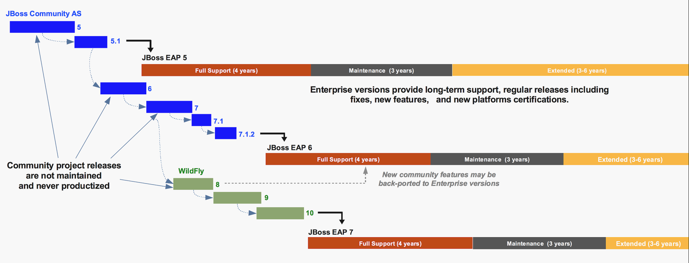
JBoss EAP 6 & 7
Support Lifecycle

Slide 12
JBoss EAP 6 & 7
Support & Tested Configurations
JBoss EAP 6 | JBoss EAP 7
OpenJDK 1.6, 1.7, 1.8 OracleJDK 1.6, 1.7, 1.8 | OpenJDK 1.8 Oracle JDK 1.8
RHEL 5,6,7 | RHEL 6,7
Oracle 11g R1, 11g R1 RAC, 11g R2,12c | Oracle 11g R2, 11g R2 RAC, 12c
JBoss EAP 6 Supported Configurations | JBoss EAP 7 Supported Configurations

Slide 13
JBoss EAP in DoD

Slide 14

JBoss EAP Security
Security and Compliance
Common Criteria Certified EAP 6.2 & later 6.x series
Configurable for FIPS 140-2 compliance
Simplified Patch Management

Slide 15
JBoss EAP Security
Common Criteria Certified
JBoss EAP 6.2 version and later 6.x series are Common Criteria Certified (CCC)
In CCC, Evaluation Assurance Level (EAL) represents the depth and rigor of the evaluation
EAP 6.2 and later are certified for EAL 4+
EAL 4+ is the highest evaluation for commercial software

Slide 16
JBoss EAP Security
Configurable for FIPS 140-2
JBoss EAP FIPS 140-2 Compliance can be assured with
Password Complexity
Using NSS Database with JBoss EAP
FIPS Compliant Password Vault

Slide 17
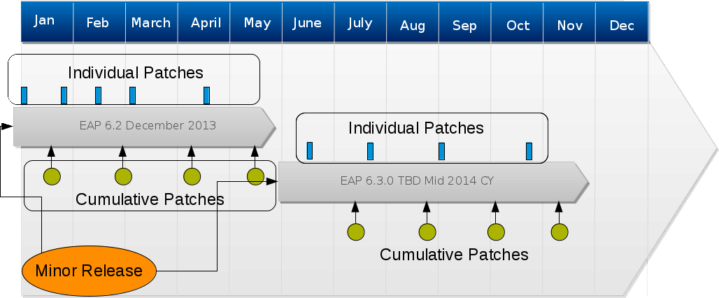
JBoss EAP Security
Simplified Patch Management
As of JBoss EAP 6.2
Individual patches for EAP 6.2.x and later versions released every 4-6 weeks as needed
Minor releases scheduled for every 6 months via a cumulative patch
If using Zip installed use CLI for patch management. No more patch scripting.

Slide 18
JBoss EAP Migrations Tooling

Slide 19

Windup
A JBoss EAP Migration Tool
Open source tool under JBoss Project:
Analyzes your Java EE application code and artifacts
Helps developers estimate and carry out application migrations
Used throughout phases of a migration

Slide 20
Windup
Tooling Help You
Windup helps you with:
Migrate to non-proprietary code
Upgrade / standardize frameworks
Find deprecated code and resources

Slide 21
Windup
Tooling Shows You
Windup shows you:
Proprietary libraries
Proprietary configurations
WAR/EAR descriptors
Service locators
Web Services
EJB descriptors
Deprecated Java code

Slide 22
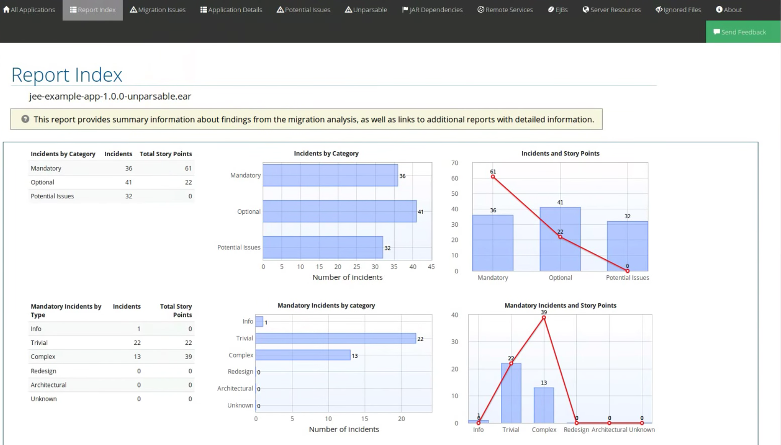
Windup
Tooling Gives You
Windup gives you a report that highlights
Story Points per findings
Complexity of findings
JAR Dependencies
Mandatory vs Optional Fixes
Suggestions on Fixes

Slide 23
Red Hat Migration Methodology

Slide 24
DOES THIS LOOK FAMILIAR?
[ 1]
YOU ARE
CURRENTLY USING AN EE CONTAINER
[2]
YOU HAVE BEEN TASKED WITH MIGRATING/UPGRADING TO RED HAT JBOSS EAP
[3]
YOU ARE
UNFAMILIAR WITH WHAT IS AHEAD

Slide 25

40 HOURS TO MIGRATION ONE APP
CHECK OUT
the sources from version control
DETERMINE
vendor-specific code
DETERMINE
vendor-specific configuration files
DETERMINE
provided/consumed services
FIND
resource references:
• Databases
• Queues

Slide 26

THERE MUST BE ANOTHER WAY
20 APPLICATIONS
40 HRS/APPLICATION
800 TOTAL HOURS
20 WEEKS
250 APPLICATIONS
40 HRS/APPLICATION
10,000 TOTAL HOURS
5 YEARS

Slide 27
RED HAT MIGRATION METHODOLOGY
Discover, Design, Deploy
DISCOVER |  | DESIGN |  | DEPLOY
Discovery Session: Discuss options |  | Define Migration Strategy, Prove Technology and Business Case |  | Migration Factory: Scale & Execute
Explore
Analyze
Prove
Plan
Migrate in Iterations

Slide 28




MIGRATION PROCESS - DESIGN
CATALOG & ASSESS MIGRATIONS EFFORT WITH AUTOMATED TOOLING
RATIONALIZE APP PORTFOLIO
DEFINE PILOT PROOF/
APP MIGRATION
ITERATIVE APPS/SCALE MIGRATION
^{PHASE 1: ASSESSMENT}
^{PHASE 2: EXECUTION/DELIVERY}

Slide 29


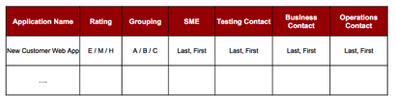

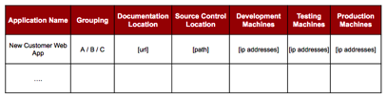
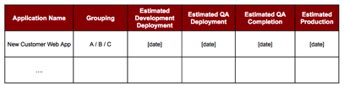
MIGRATION PROCESS - DESIGN
CATALOG
RATIONALIZE
PLAN
Discovery
A
C
B
D
E
F

Slide 30

MIGRATION PROCESS - DEPLOY
CATALOG AND ASSESS MIGRATIONS EFFORT WITH AUTOMATED TOOLING
RATIONALIZE APP PORTFOLIO
DEFINE PILOT PROOF/
APP MIGRATION
ITERATIVE APPS/SCALE MIGRATION
^{PHASE 1: ASSESSMENT}
^{PHASE 2: EXECUTION/DELIVERY}

Slide 31

MIGRATION PROCESS - DEPLOY
Divide, Scale & Conquer
A
C
B
D
E
F
CENTER OF
EXCELLENCE
KNOWLEDGE
BASE
MIGRATION
TEAMS
(1…N)
CHALLENGE
BACKLOG

Slide 32
RED HAT CONSULTING HELPS YOU
PLAN
IMPLEMENT
SUCCEED

Slide 33
Questions?

Slide 34
THANK YOU
plus.google.com/+RedHat
facebook.com/redhatinc
linkedin.com/company/red-hat
twitter.com/RedHatNews
youtube.com/user/RedHatVideos

Slide 35
Backup Slides

Slide 36
AGENDA
Date and/or title of event
8:00AM—9:00AM
8:00AM—9:00AM
NAME OF TOPIC
NAME OF TOPIC
8:00AM—9:00AM
8:00AM—9:00AM
NAME OF TOPIC
NAME OF TOPIC
8:00AM—9:00AM
8:00AM—9:00AM
NAME OF TOPIC
NAME OF TOPIC
8:00AM—9:00AM
8:00AM—9:00AM
NAME OF TOPIC
NAME OF TOPIC

Slide 37
JBoss EAP 6
Fully Modular Classloading System
Java EE 6 standard compliant
Offers application isolation
Hides server implementation classes, only loads classes needed by the application
Concurrent loading of classes vs hierarchical

Slide 38
JBoss EAP 6
Boot Process
In previous versions:
All services were loaded on boot time
Required slimming unwanted of out of the box functionality
EAP 6 introduces lazy loading of unwanted services and concurrent start of needed services

Slide 39
JBoss EAP 6
Flexible Management
Management Interface: All functionalities consolidated in one console
Command Line Interface (CLI)
/subsystem=logging/logger=org.jboss.security:write-attribute(level=INFO)

Slide 40
JBoss EAP 6
Directory Structures and Scripts
The JBOSS_HOME/server directory has been removed
Standalone mode:
Configuration files are now located under JBOSS_HOME/standalone/configuration
Deployments directory under JBOSS_HOME/standalone/deployments
For domain mode replace “standalone” with “domain”

Slide 41
JBoss EAP 6
JMS
JBoss Messaging is replaced by HornetQ
Existing messages in JBoss Messaging database would be migrated to HornetQ Journals
Queues, Topics etc are now configured in profile XML files

Slide 42
JBoss EAP 7
What is gone and Replaced
Dropped EAP 6 subsystems
CMP
JAXR
Threads
OSGi
Removed support
CMP EJB → JPA
JAX-RPC → JAX-WS
JSR-88 → CLI / management console / scanner / maven

Slide 43
JBoss EAP 7
What has been replaced
Subsystems replaced by new ones with different configuration models
web → undertow
HornetQ → ActiveMQ Artemis
jacorb → iiop-openjdk

Slide 44
JBoss EAP 7
What has been added
Enhancements for Management Console
Offline CLI
Port Reduction:
8080 – for applications with JNDI and EJB multiplexed
9990 – for management, for both HTTP/JSON & native API
SSO – PicketLink + KeyCloak

